Slide 1
BUILDER PATTERN
A patterns-box talk
by
Jose Palacios

Slide 2
About me
Hi, I’m Jose, Software Engineer 3 at Belatrix. Currently I’m working at La Familia Team on the convertion modules

Slide 3
01
02
03
04
Goal
Real world case
Architecture
Problems it solves

Slide 4
05
06
07
08
When to use it?
When not to use it?
Common mistakes
Advantages

Slide 5
Goal
Separate the construction of a complex object from its representation so that the same construction process can create different representations
Notes:
so, what does it mean? …
let’s have in mind that this pattern is a creational pattern – in other words, it's used to create and configure objects
so to summarize, the main goal of this pattern is to reuse this logic to work with a different set of data to build the same thing.

Slide 6
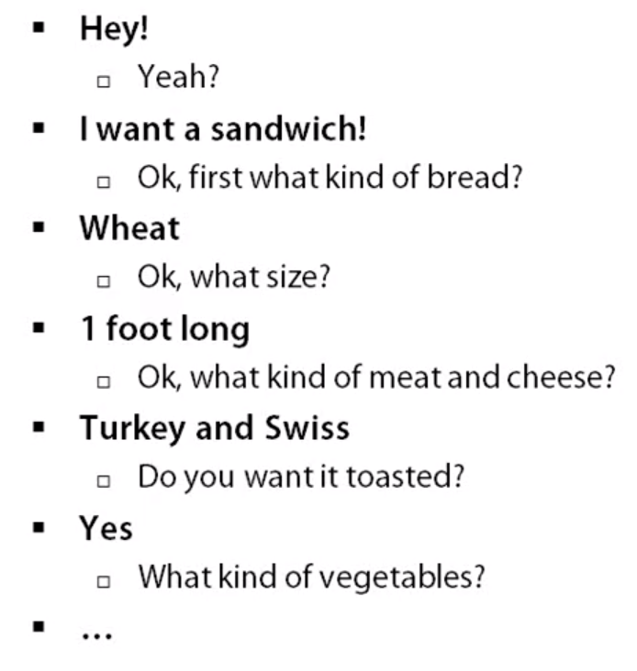

Real world case
Notes:
so, lets start digging into this pattern with a basic example of buying a sandwich
So on and so for, i’m sure that if you go for a sandwich it could be annoying to answer all this questions and we often just pick a number of the menu and so this is a kind
of example of code you may have that has all extra dialog and maybe you’ve thought well i can put all in a constructor and so you gave a large constructor where you pass in all these parameters.

Slide 7
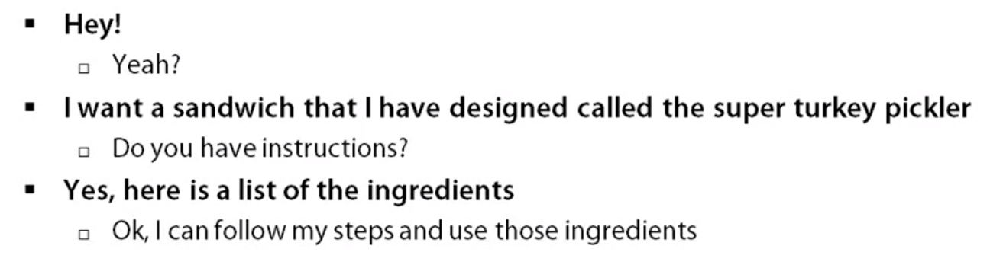
Real world case
Notes:
So, this dialog is much shorter, so this kind of scenario that might not really happen in a real sandwich shop, but it would be pretty efficient if it did.
so the basic idea here is that you’re only Providing data. you are not going to the sandwich shop in this case and you are not saying
First cut the bread, and then put some meat etc. you are not going to that entire Process and giving them detailed steps, instead, you’re giving them a list of ingredients
and then they are going to follow the steps that they already know on how to make a sandwich, and every place that there’s a question they need some data, they are going to get that from your ingredients list

Slide 8
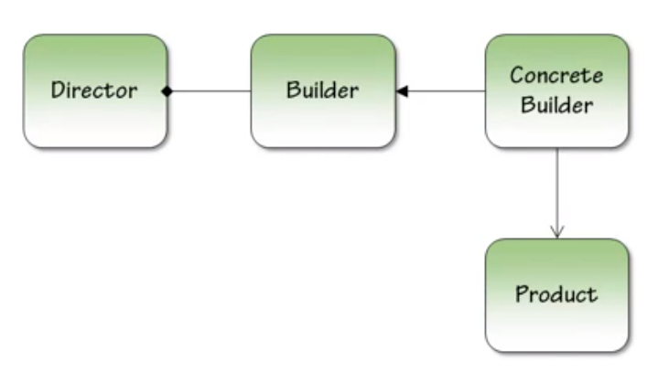
Architecture
Notes:
At this point let's start talking about the participants of this pattern
The Participants
The Builder which is the core,is used by the Director, and that builder is implemented by a Concrete Builder so we have a concrete version of our Builder, is actually an object that we can instantiate. And then we have a Product that the Concrete Builder is able to produce.
So basically we create a concrete builder, we give it to the Director and this class follows a step or has the process to Build a Product. And so the builder in this examples is going to define for us what the steps are. And the director is going to put those steps in the right order.

Slide 9

Problems it solves
Too many parameters
Order dependent
Different constructions
Notes:
This is probably a common problem that you have seen in your code and we are gonna see how this pattern solve this
So sometimes when we construct an object with many parameters we have to follow an order and so we usually don’t remember what does all these parameters means and that’s gonna be an issue for us
We are going to find that we need to be able to construct different objects or different constructions of that object and so we need to be able to abstract out the process from the data, a lot of times in patterns we are gonna find this common idea of abstracting away data and process so we can take logic and data separate them out, and that’s gonna give us actually a Builder Pattern

Slide 10

When to use it?
Telescoping constructors
When you need different representations of the same object
Notes:
There is at least two code smells to look out for when determining if the builder pattern is right for you:
Telescoping constructors are when you have multiple constructors, each to handle a specific scenario to create the object.
That means when you have to create different kinds of products or objects following the same steps but with its specific data.

Slide 11

When not to use it?
When you don’t need different configurations of the same object
Notes:
Because real the purpose of the pattern is to reuse the building logic with different data. if you have only one set of data you are creating an overhead, not getting a lot of value.

Slide 12

Common mistakes
Forcing the pattern
Notes:
Force to apply the pattern when you don’t need it. For instance, when you only have one parameter in the construction of the object

Slide 13

Advantages
Single Responsibility Principle.
Open/Closed Principle.
Scalability
Testability
Notes:
We are following this principle while having each functionality logic and data in their correspondent class
Once finished an implementation, you can keep creating additional abstractions without affecting the created ones
As mentioned before, having the functionalities separated allows an easier way to scalate simply by adding the functionalities without affecting the others
Also, it is easier to test each of this classes since they are separated and focused in a specific task

Slide 14
Demo
Notes:
So now, let me present a short demo of this pattern.

Slide 15

Thanks

